Slide 6
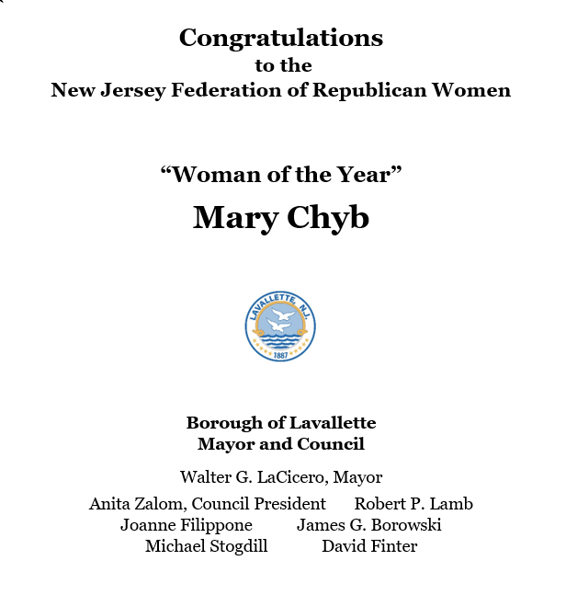

Slide 8
Woman of the Year Mary Chyb's Family

Slide 9
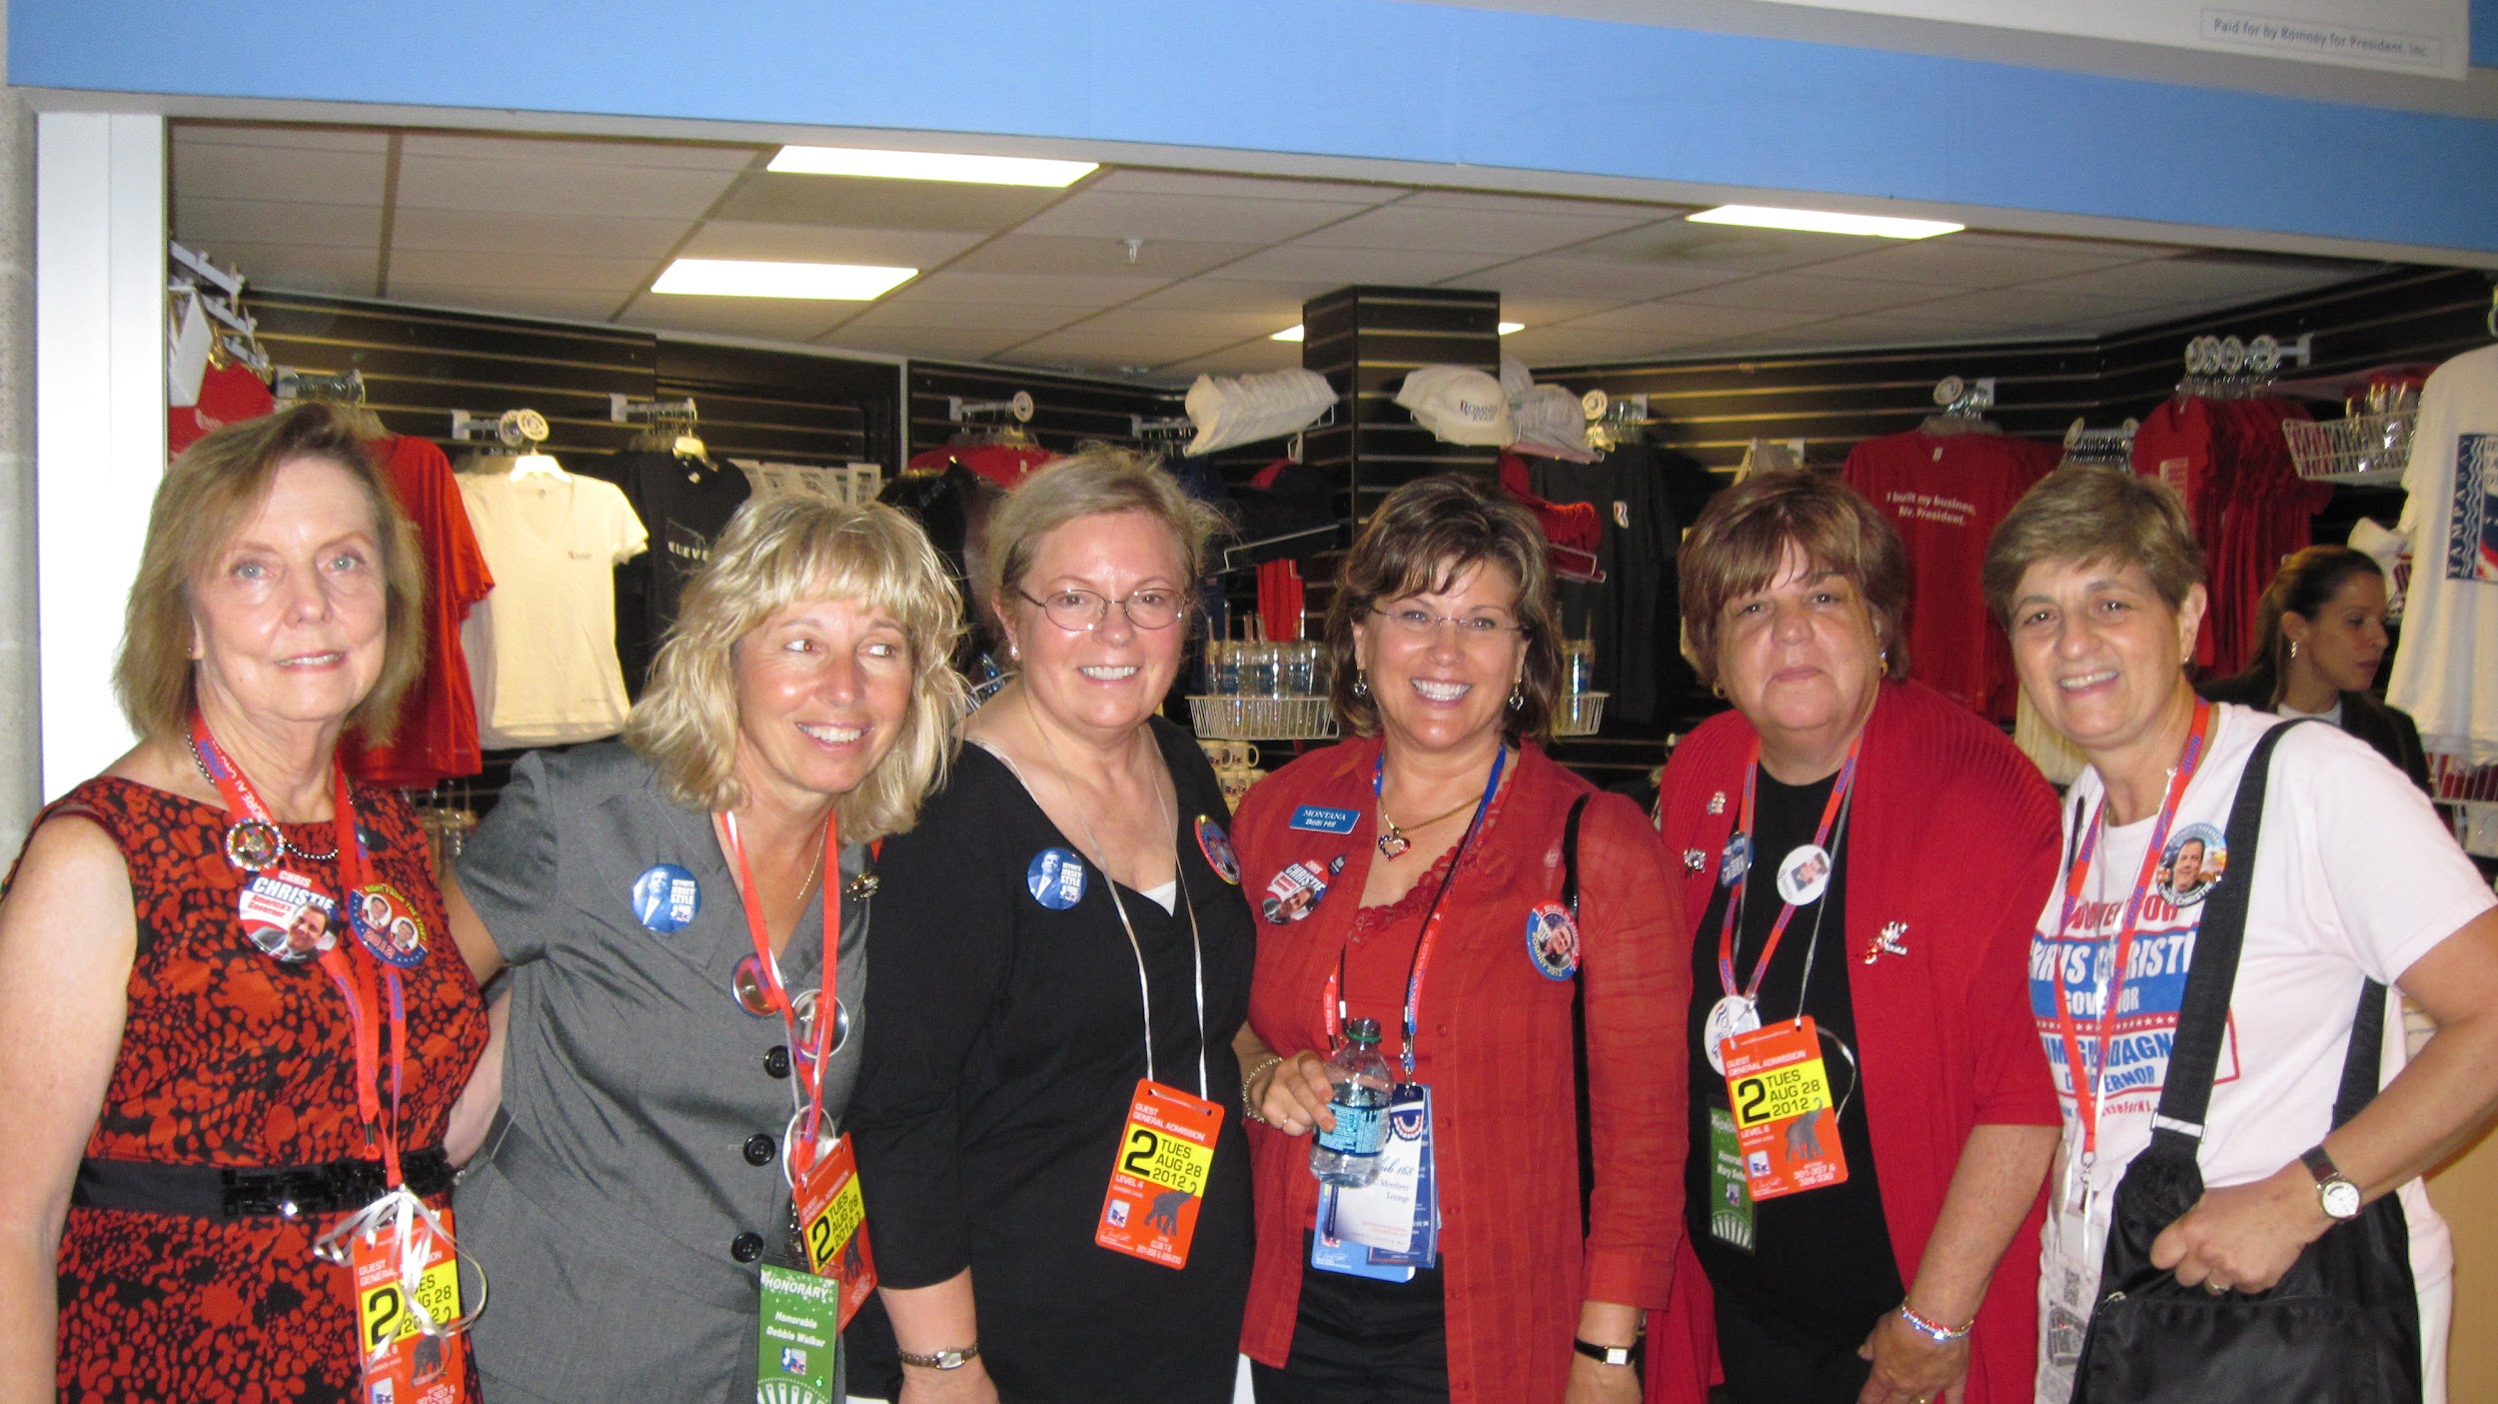
Tampa Convention 2012

Slide 10
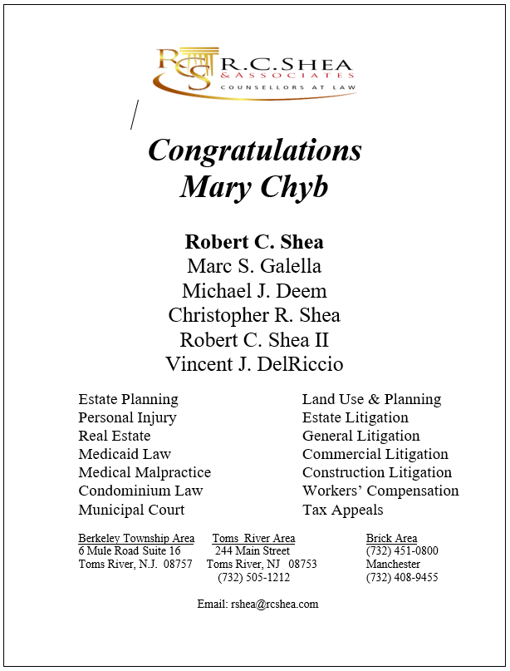

Slide 13
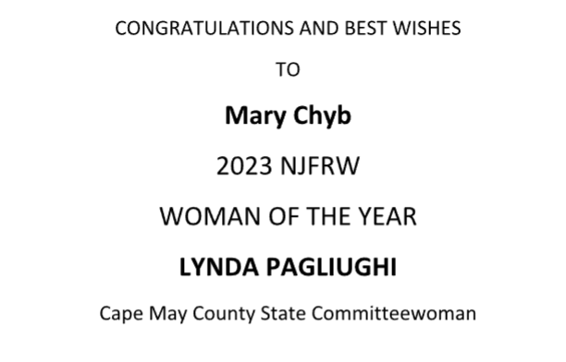

Slide 15
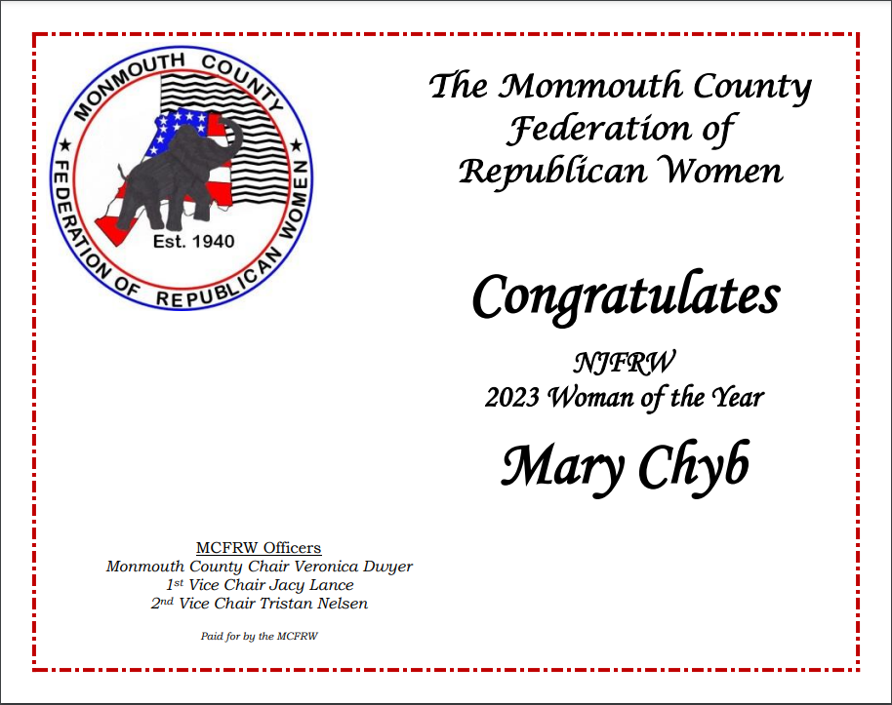

Slide 16
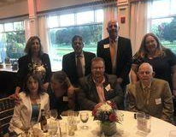
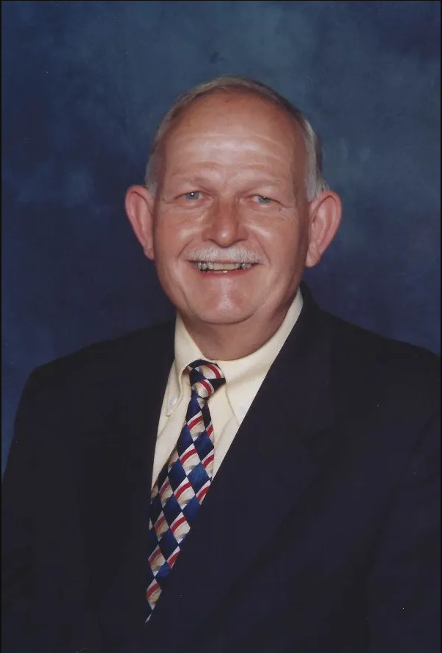
In Memoriam - Harry Brown December 16, 1946 - May 21, 2023

Slide 17
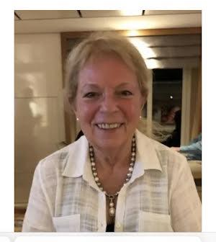
In Memoriam - Sue Tisiker January 29, 1943 - January 13, 2022

Slide 18
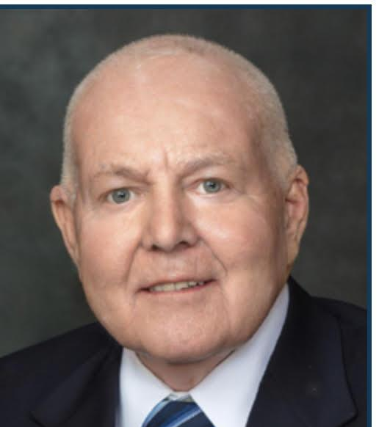
In Memoriam - Ron Dancer May 31, 1949 - July 23, 2022

Slide 19
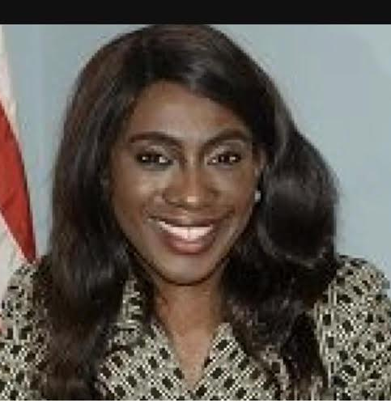
In Memoriam - Eunice Dwumfour April 4, 1992 - February 3, 2023

Slide 23
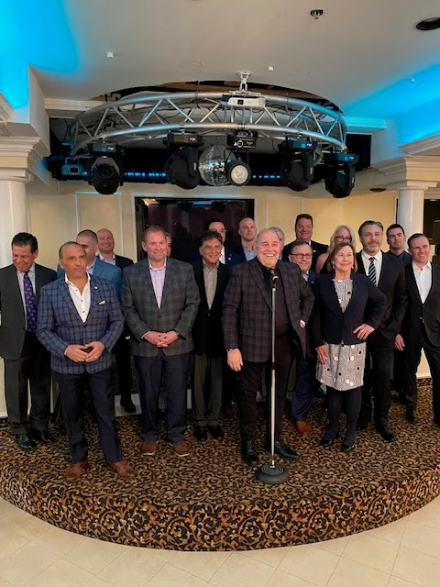
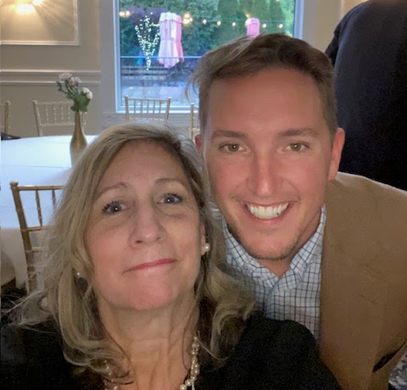
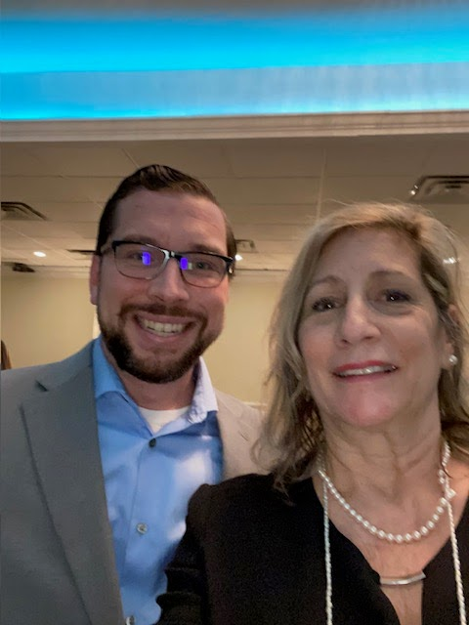
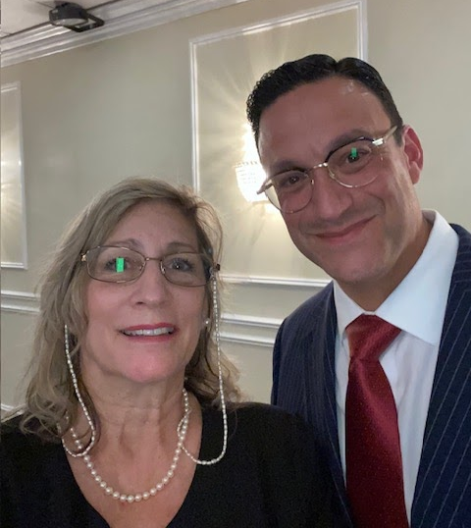
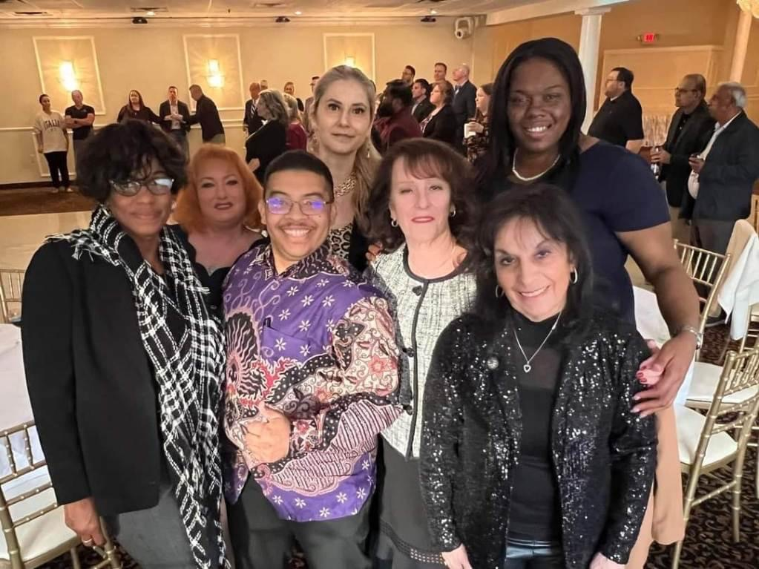
2023 Chairman Jose Arango’s Spring Fundraiser

Slide 27
Magdalena Jenny Joey Chyb at the Bazaar

Slide 28
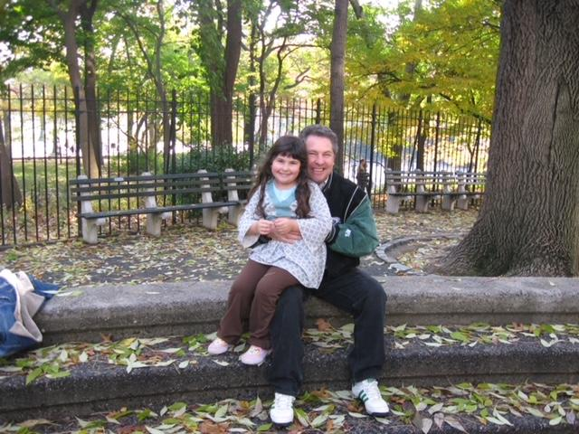

Slide 29
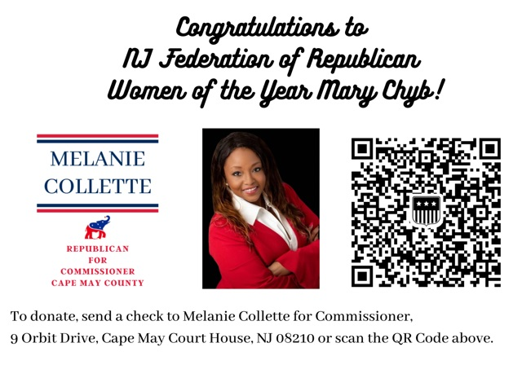

Slide 30
President’s Message

Slide 32
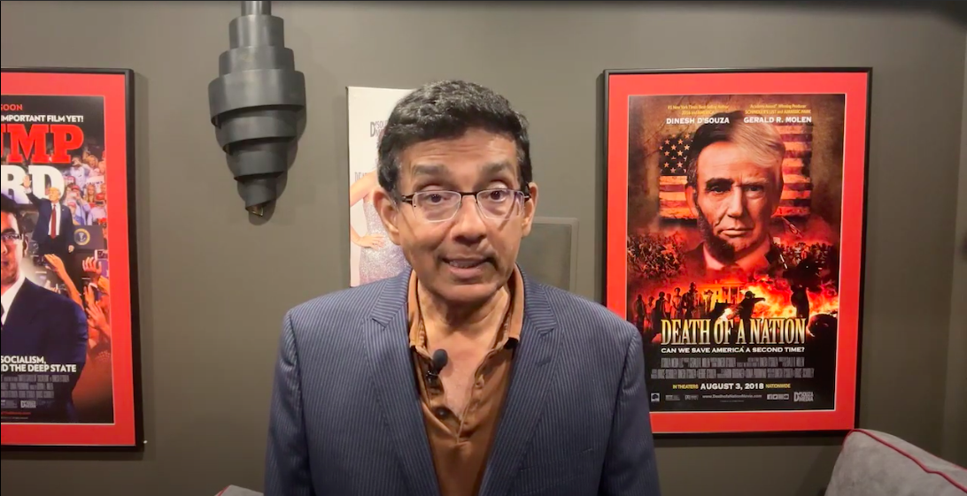

Slide 33
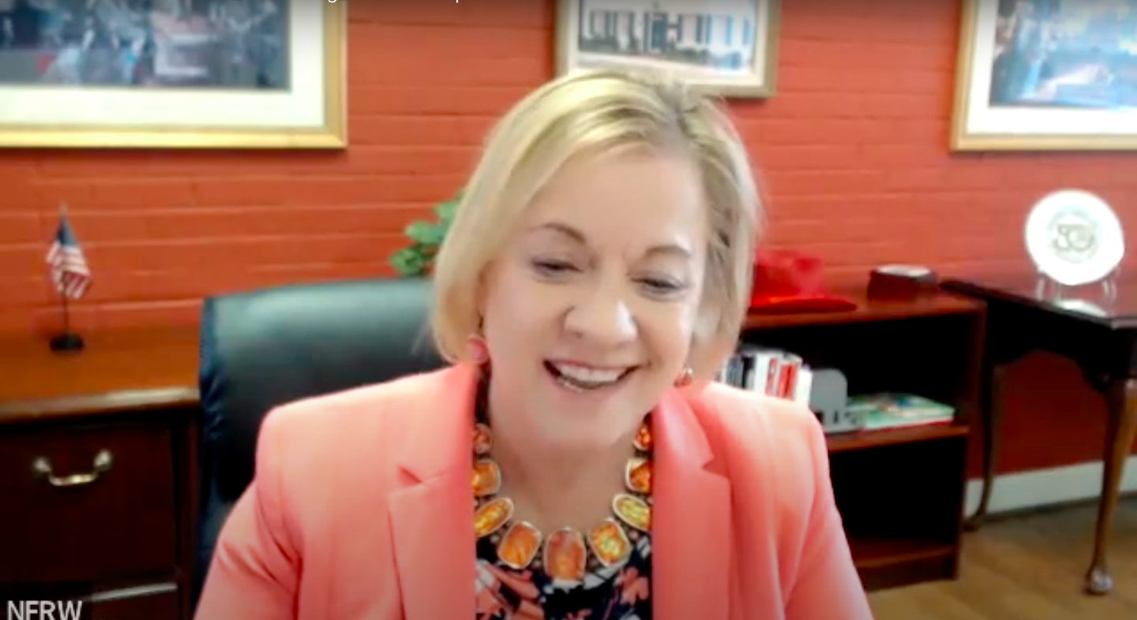

Slide 36
“Charm is deceptive, and beauty is fleeting; but a woman who fears the Lord is to be praised. Honor her for all that her hands have done, and let her works bring her praise at the city gate.”
Proverbs 31: 30-31
Today we honor all the incredible newly installed to the Board of the New Jersey Federation of Republican Women!
Rose Yerka
NJFRW Chaplain

Slide 38
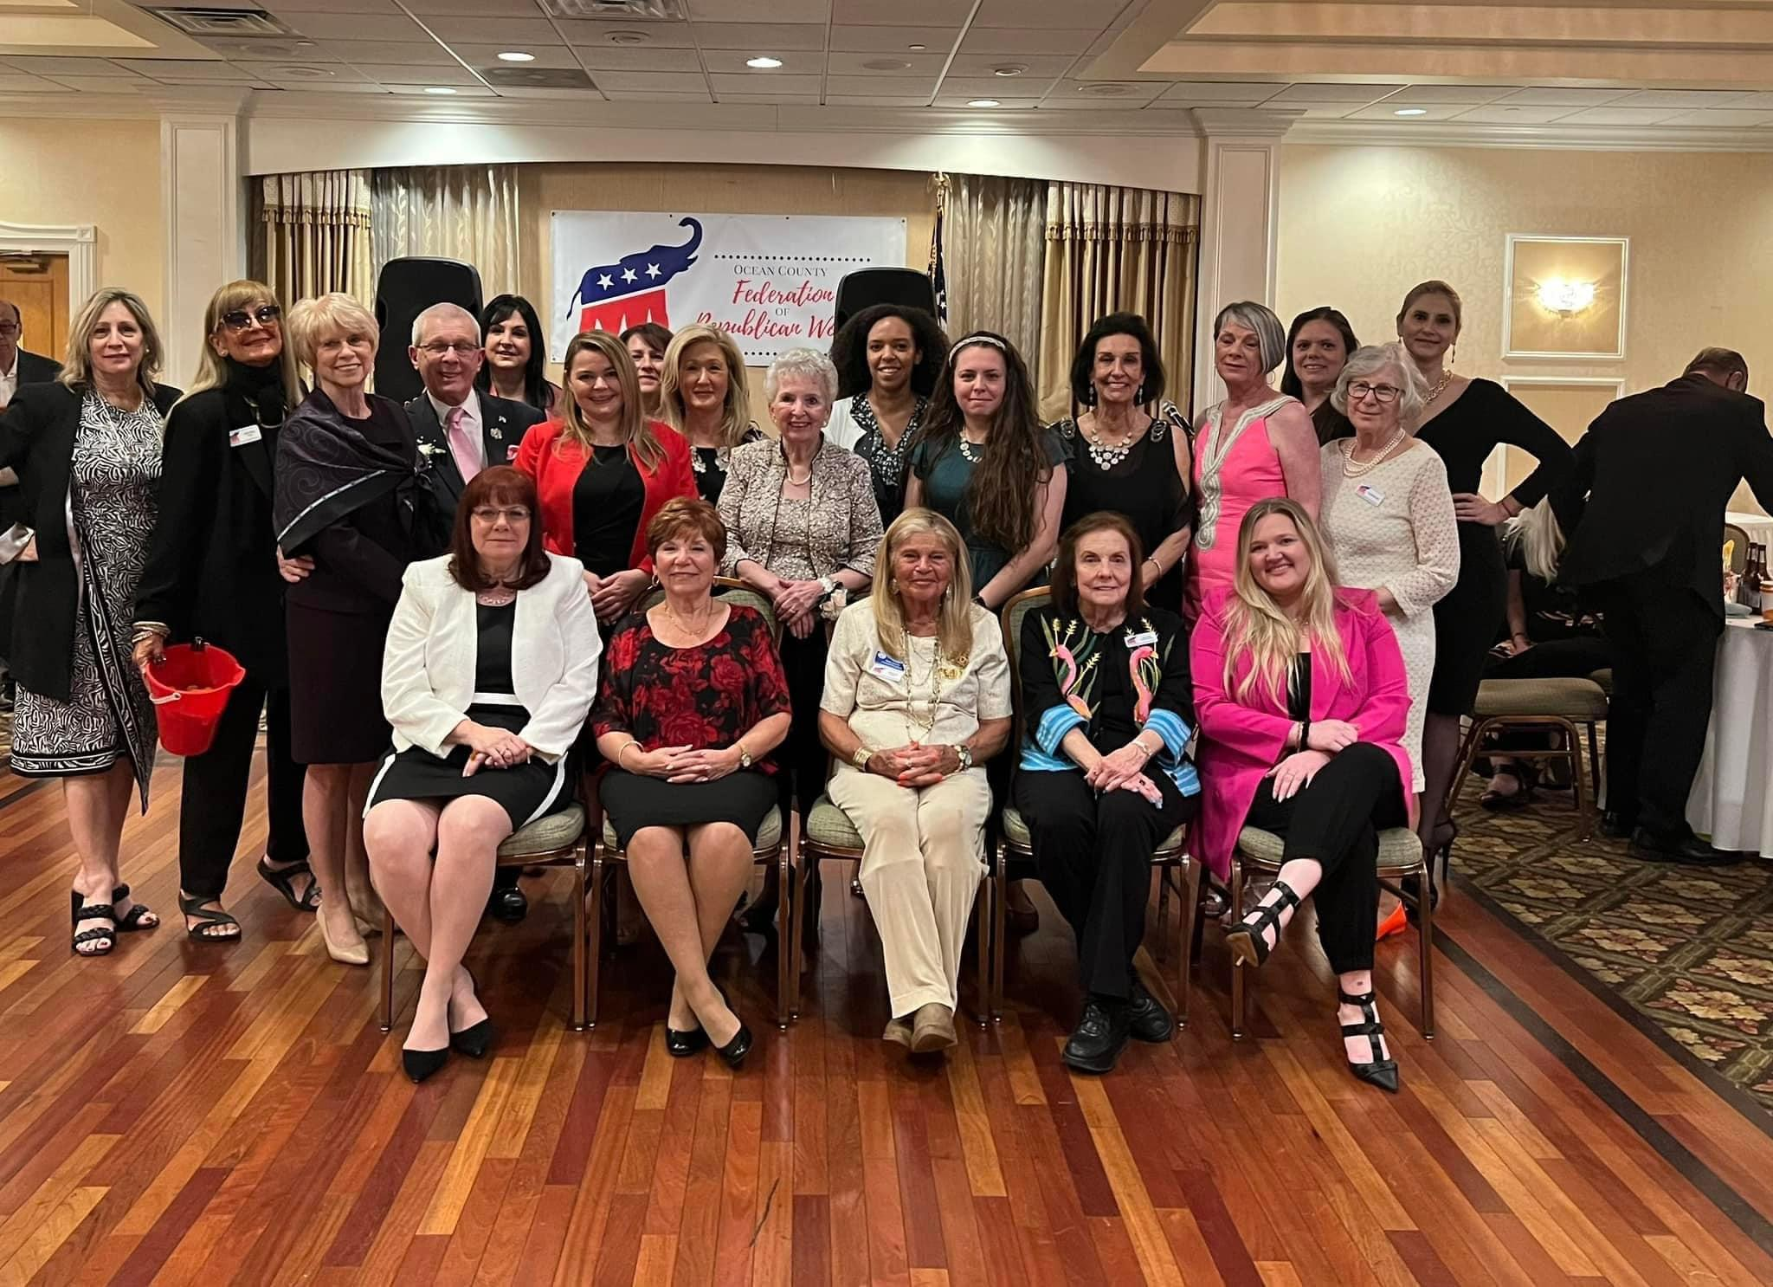
Mary Chyb and the Ocean County Federation of Republican Women 2023 Annual Gala

